Slide 1
Quality Catch 5.0
Updates to support NAMQ use of Wayfinder and PIRE/PIR trending.

Slide 2
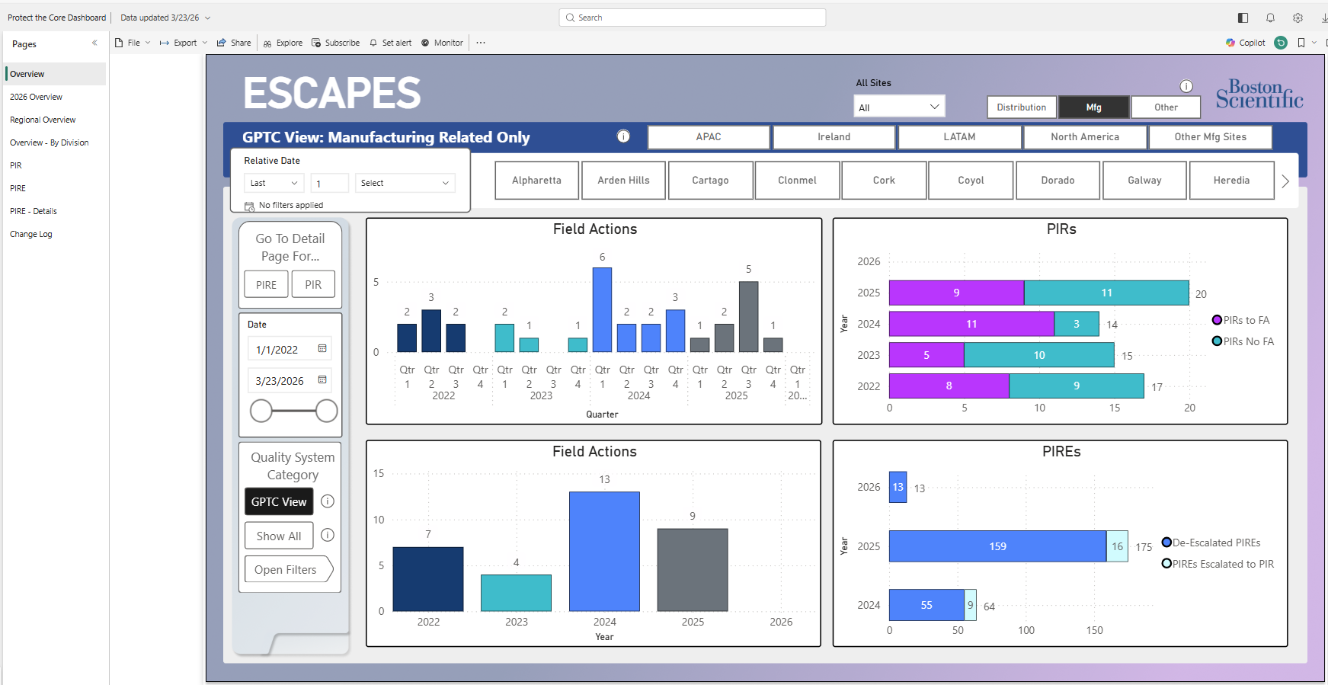
5.0 Updates
Human Error investigation questions (Slide 3 and 4)
Reports Section
  NCEP PIRE/PIR Trending: show the number of open catches that still require trending to be completed.
  NCEP Catch Status Report: show the number of open catches after the NCEP has been Closed.
Details section (Slide 5)
eCAPA connection (Slides 6 and 7)
  NCEP
    Allows “push” of Manufacturing NCEP data to Quality Catch and will automatically initiate a new Catch.
    If there is an existing catch and you update record to “Is an NCEP required” - Yes - and add NCEP number, system will merge eCAPA data to existing record.
    NAMQ sites will record all Manufacturing NCEP’s into Quality Catch as part of Wayfinder. Other sites and functions can opt in via a Simple Apps ticket request.
  PIR/PIRE
    Data will be utilized to feed Overview - Protect the Core Dashboard - Power BI
    Any Manufacturing or Distribution NCEP with PIR Escalation Approval Date
    and/or PIR number in eCAPA will have a catch created automatically with both
    NCEP and PIRE and PIR Trend Data sections populated and active.

Slide 3
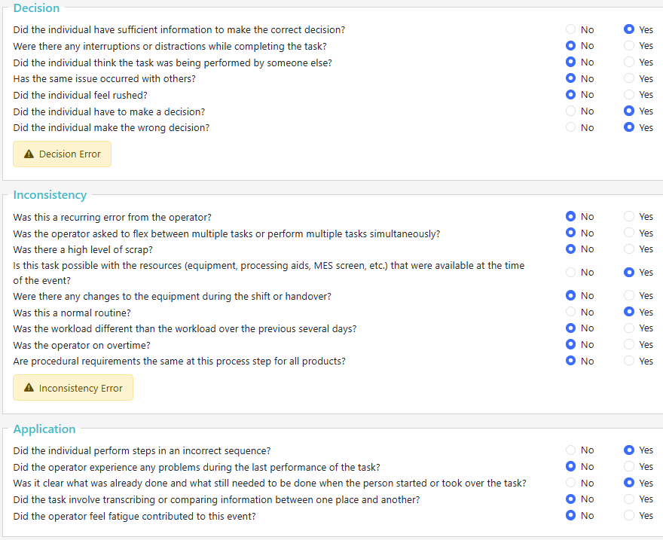
Human Error Investigations - New
Spencer will be only site set to show this by default – any site can opt in.
  Site facilitator can elect if this is a displayed (and also) required field thru Manage Fields under the Actions Menu.
If Operations is answered Yes or N/A then Decision, Inconsistency, Application, Memory, Omission, Learning sections will open up
Nearly full question set is shown here, they are smart and will adjust based on answers within each section.

Slide 4
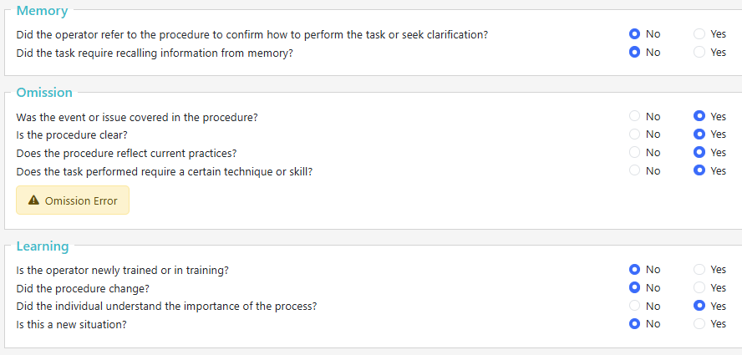
Human Error Investigations - New
(Cont.)

Slide 5
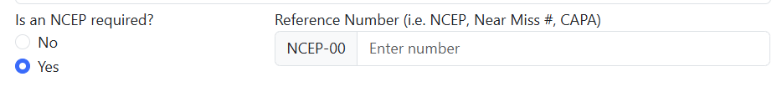
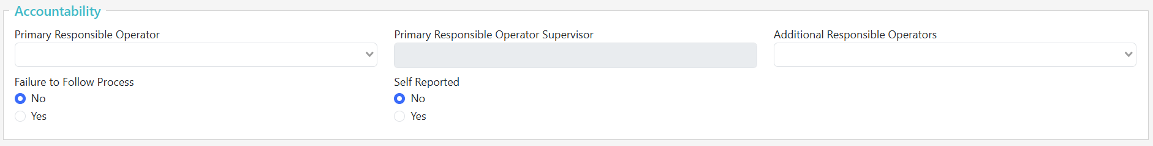
Details Section - Updates
If recording NCEP’s in Quality Catch:
  If a record is initiated in Quality Catch prior to eCAPA, you must update this question to yes and record your NCEP number here. Example: You opened a Quality Catch and later determined it was an NCEP due to a non-conformance. This will import your eCAPA NCEP data to this Quality Catch. If you do not complete this, it will result in another Quality Catch record being created (your original and the eCAPA one).
MDS/Responsible Operator section moving to its own section titled Accountability

Slide 6
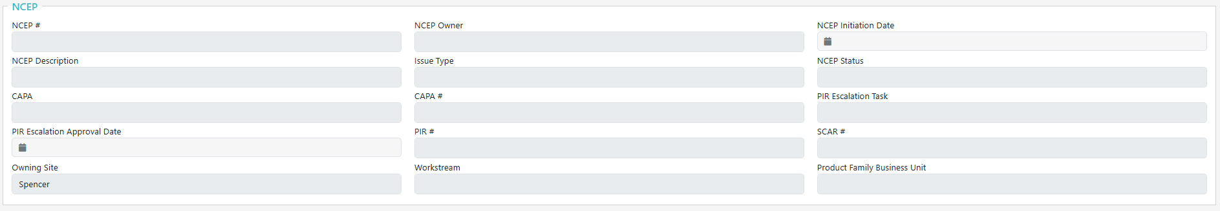
NCEP Section - New
North America Manufacturing region will display by default, others by opting in via Simple Apps ticket. Other sites will only see if you have a NCEP with PIRE/PIR.
This will continue facilitation and growth of the Quality Wayfinder program.
If using, Quality Catch record cannot be closed until NCEP Status is CLOSED (eCAPA)
“Live” updates as eCAPA record is updated – users do not populate this section
NCEP owner will receive an email with a link to the created Quality Catch.
Catch Owner will have to update rest of Catch record as current practice

Slide 7
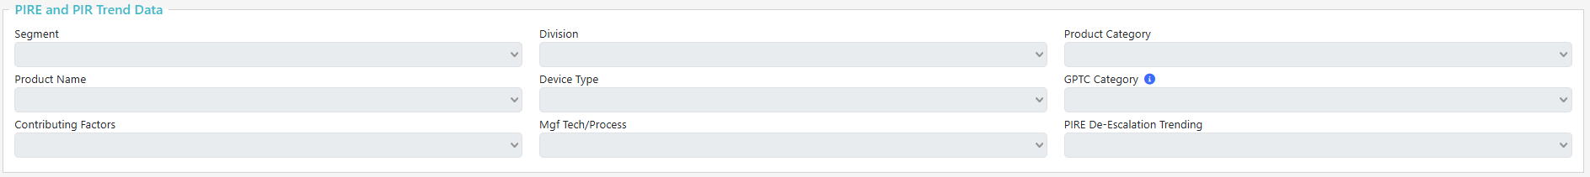
PIR and PIRE Trend Data - New
Any Manufacturing or distribution NCEP with a PIR Escalation Approval Date and/or PIR Number in eCAPA regardless of region will be required to update these sections
Seciton will become “active” with PIR Escalation Task, Approval / PIR # in eCAPA
PIR / PIRE owner must complete each dropdown selection.
This data will be used to populate the PTC Dashboard

